Slide 1
Jewish Family & Children's Service of Greater Philadelphia
B’ZELEM ELOHIM – IN GOD’S IMAGE: Integrating Spiritual Practices into Programming with People with Disabilities
Rabbi Tsurah August - Rabbi and Chaplain; taugust@jfcsphilly.org
Or Ben Ari, LCSW - Program Manager; obenari@jfcsphilly.org
Lisa Ney, LCSW – Director, lney@jfcsphilly.org

Slide 2
People With Disabilities Program – Overview
Mission: PWD takes a holistic approach to support and help individuals with disabilities and their families, in their quest to achieve stability, the highest level of independence, a sense of community and an enhanced quality of life.
Who Do We Serve:
Adolescents and adults with developmental disabilities, including autism, and learning differences
Mental Health Diagnoses
Less severe challenges
Typical client: people in transition, isolated, unaffiliated, low income

Slide 3
Core Pillars of Service
Support Services: care management, counseling, art therapy, support groups (caregiver and peer)
Life Skills
Community Programming: create inclusive spaces to come together
Socialization and Outings
Transition
Social Action and volunteering (doing for the community)
Advocacy (finding our voices)
Community Awareness and Trainings

Slide 4
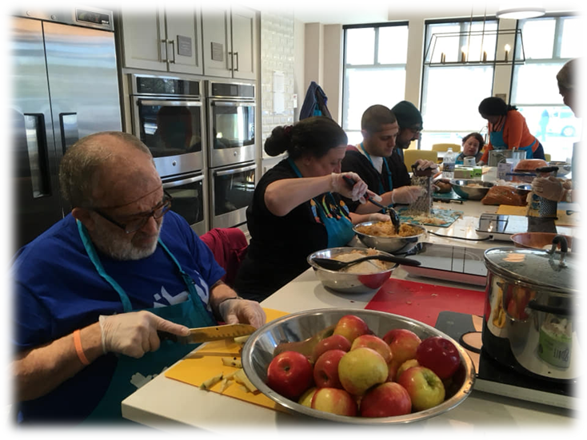
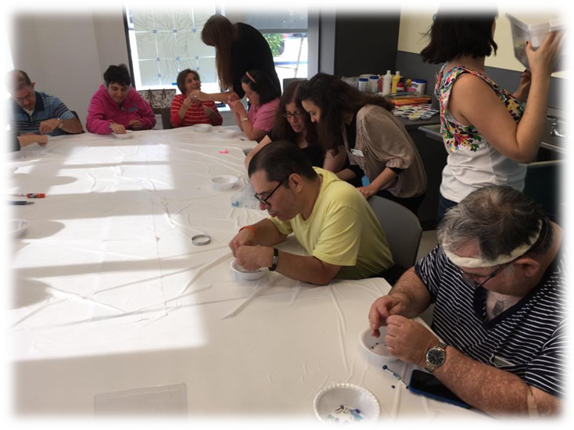
Brodsky Center Activities

Slide 5
Baking with a Mission
Started as a partnership with Challah for Hunger
Once a week, daytime hours
Participants bake, package and sell challah and other baked goods to help those in need
Truly inclusive program – service learnings together to raise awareness in the community about food insecurity
Work together in pairs – clients are experts
Raising money for food insecurity
Students learn empathy and are given tools to increase acceptance of others
Lessons Learned

Slide 6
Student Feedback Survey – Baking with a Mission

Slide 7
Creative Writing
Importance of stories
Worked with different creative writing techniques (personal histories, short stories, and poetry)
Aim is to help participants become comfortable writing and sharing their personal stories, improve listening skills, creativity, personal relationships, self-worth, empathy
Created a book of poems and paintings

Slide 8
Podcast Program
Participants wrote their personal histories in our Creative Writing Workshop
Participants interviewed and recorded one another about their stories to create short podcasts.
Program aim to achieve:
Share client stories with the community
Listening Skills
Sense of community
Sense of self-worth
Increased empathy/Theory of Mind

Slide 9
Peer Support Group
Support around themes (grief, anxiety, gratitude)
Playwrights
Real actors performing for the community
Goal is to have the group be peer lead – train peer leaders

Slide 10
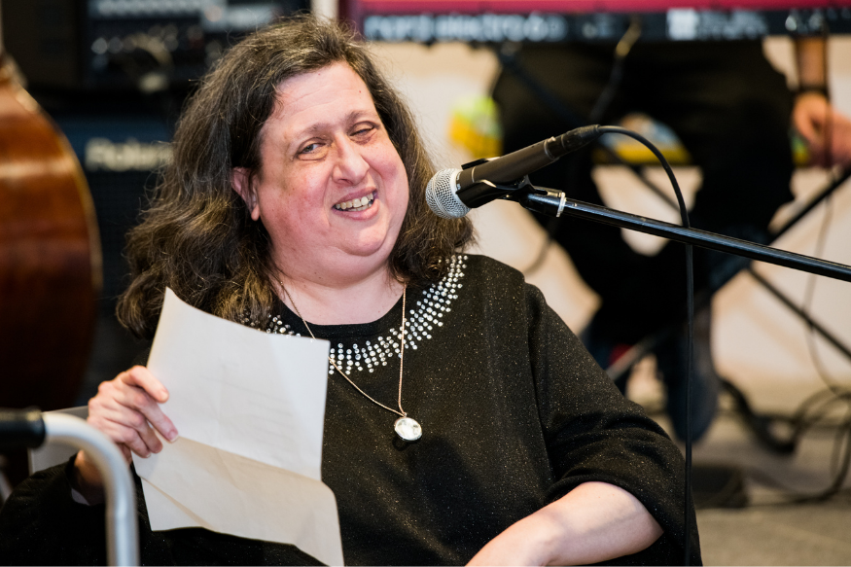
Advocacy Program
Participants learn about advocacy and raising awareness
Participants learn to use their life stories for advocacy
Changing our practice with advocates
JDAD

Slide 11
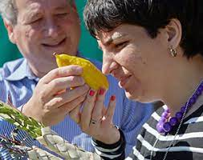
In-JOY – Inclusive Jewish Occasions Year-round
Community celebrations
Opportunities for raising awareness of inclusion
Including youth
Doing with vs. doing for

Slide 12
COVID – March 2020
Move to completely virtual platform
More intense time together as a community
Saw that virtual programs were more inclusive in some ways
Closed captioning
Seeing people in other lights
Could see into each other's home and personal spaces (pets, rooms)
Could include people from other parts of the country
Introducing Tsurahs's programming

Slide 13
"True belonging is the spiritual practice of believing in and belonging to yourself so deeply that you can share your most authentic self with the world and find sacredness in both being a part of something and standing alone in the wilderness."
Brene' Brown

Slide 16
Lessons Learned and Thoughts on Best Practices
Are we partnering with people with disabilities?
Are we including disability and belonging in DEI work?
Do we have the humility to be "called in" when we make mistakes?
Do we have the willingness to learn and unlearn behaviors and patterns?
Are we aware of when we might unintentionally be contributing to ableism?
Are we creating forums for dialogue and open conversations?

Slide 17
B'Tzelem Elohim
We all got a life to live; We all got a gift to give
Just open your heart and let it out;
We all got a peace to bring; We all got a song to sing;
Just open your heart and let it out
When I reach out to you and you to me; We become B’Tzelem Elohim
When we share our hopes and our dreams; Each one of us B’Tzelem Elohim
We all got a tale to tell; We all want to speak it well
Just open your heart and let it out;
We all got a mountain to climb; We all got a truth to find;
Just open your heart and let it out
When I reach out to you and you to me; We become B’Tzelem Elohim
When we share our hopes and our dreams; Each one of us B’Tzelem Elohim

